Slide 1
Intro to ggplot2 Damie Pak

Slide 2
Please bear with me: Switching between R and Powerpoint For questions- you can either ask directly or put in chat This is not going to show you everything- I’m going to be happy if you just walk away with a general “feel” for ggplot2 Please bear with me: Sometimes I don’t have a good explanation and I just “know” through lot of trial/error

Slide 3
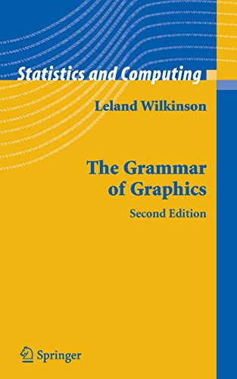
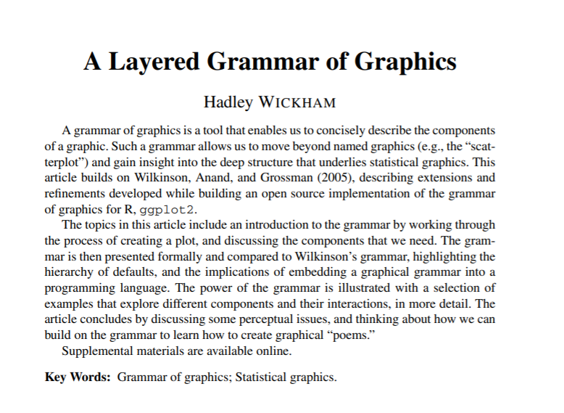
A history of ggplot2?
Importance is not on its aesthetics, importance lies in its philosophy on the structure of data-visualization.

Slide 4
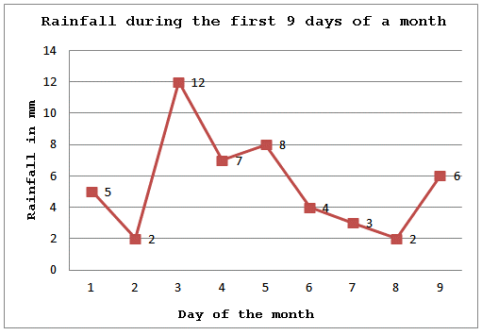
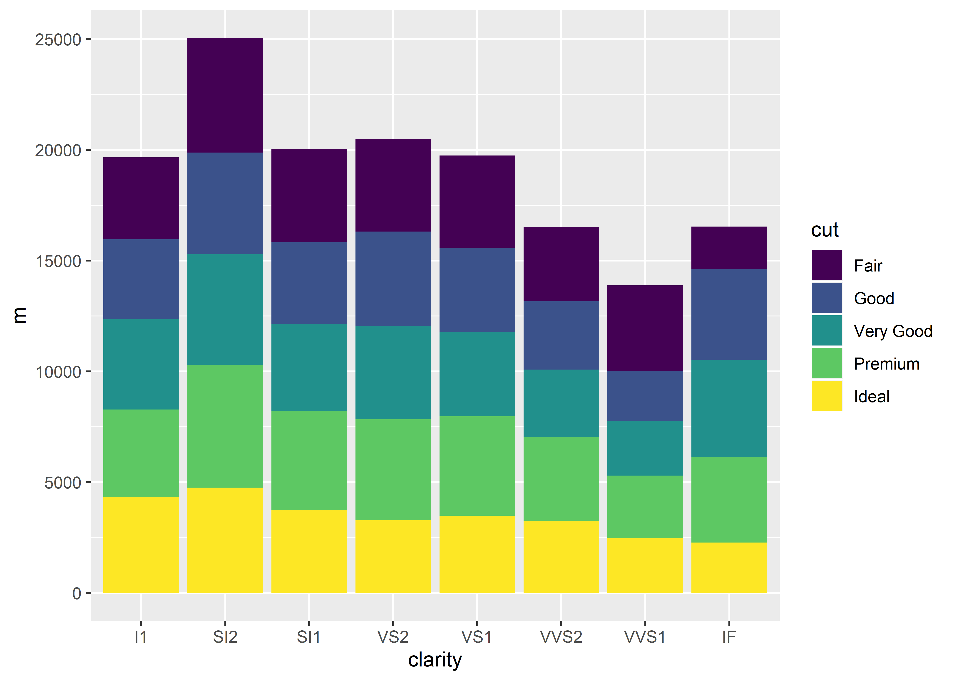
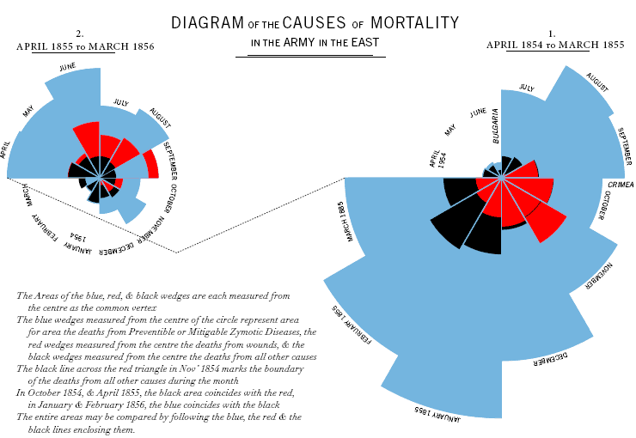

All data visualizations are built on the same foundations. When you understand the underlying grammar, you can create anything.

Slide 5
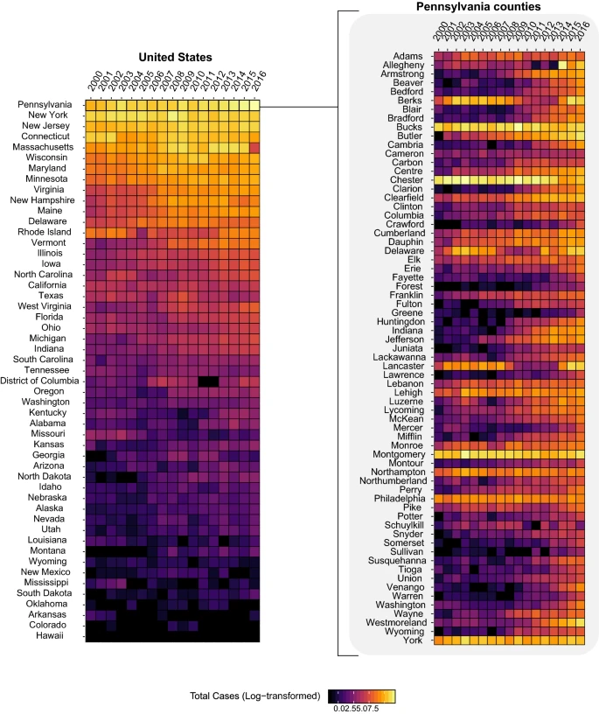
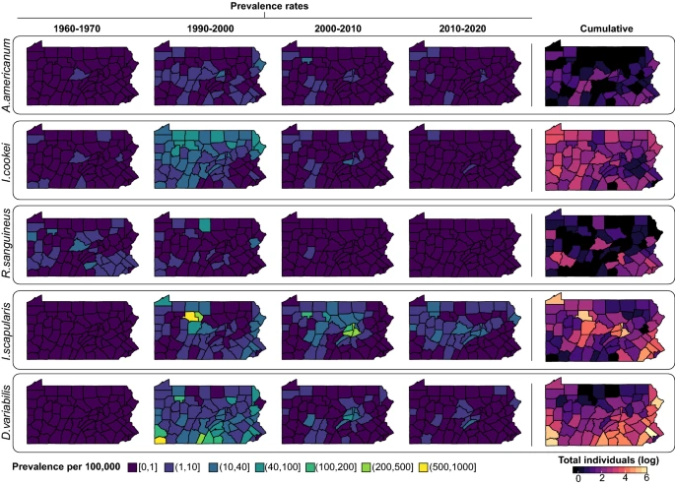
Life science is the greatest playground
Spatial
Time series

Slide 6
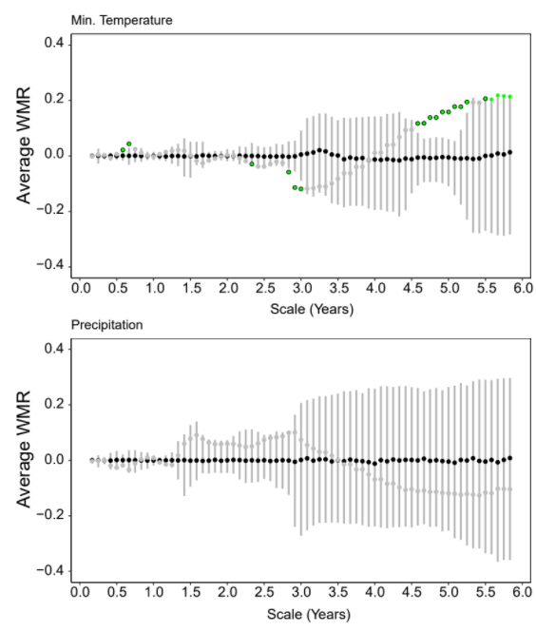
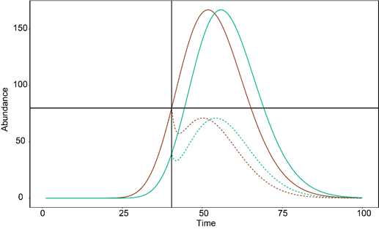
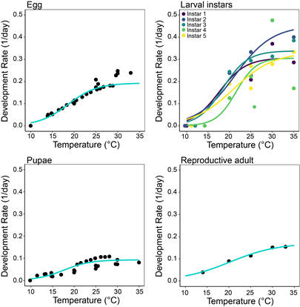
Confidence interval/Bootstrapping
Pulling stuff out of ass (aka Theoretical Ecology)
Fitting models to data

Slide 7
When you learn ggplot2, you can start thinking of more ways to represent your data

Slide 8


Slide 9
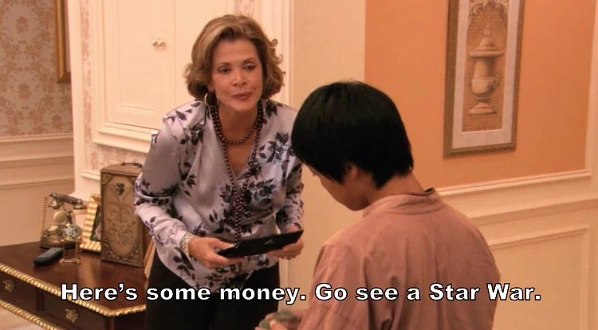
Part A: Line plots
Code
make
ggplot

Slide 10
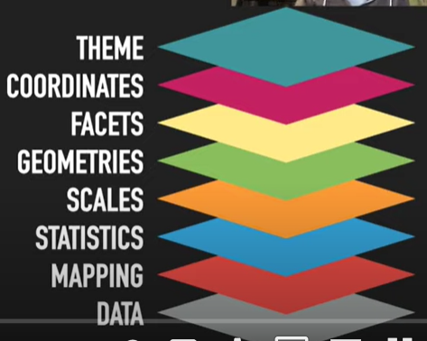
If you must walk away from the
workshop with one word:
it’s layers

Slide 11
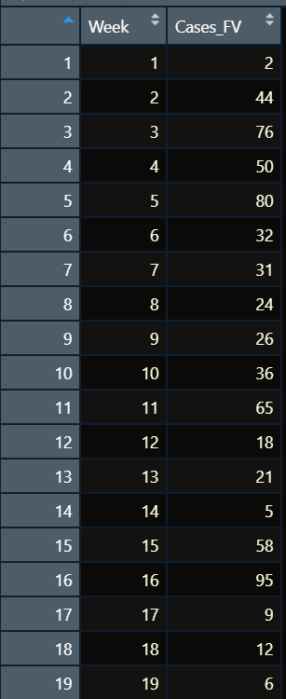
I only want to plot a single county FV- this is the data-frame. It is impossible to use ggplot without understanding what your data looks like. This is a huge boon
Starting

Slide 12
The first layer you start ALWAYS start out with is the data

Slide 13
The first layer
ggplot(data, aes(x = variable_x, y= variable_y))

Slide 14
aes is short for aesthetics
This is saying that the variables in here is linked to a visual properties

Slide 15
EXERCISE A.1

Slide 16
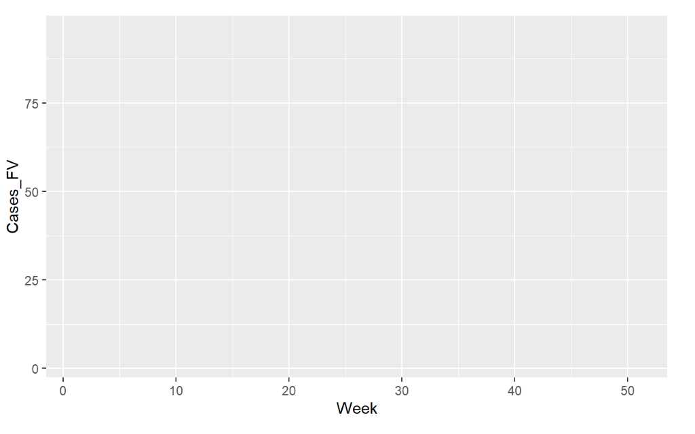
Solution to Exercise A.1!

Slide 17
The Second Layer is about Geometric Representation

Slide 18
geom_line()

Slide 19
EXERCISE A.2

Slide 20
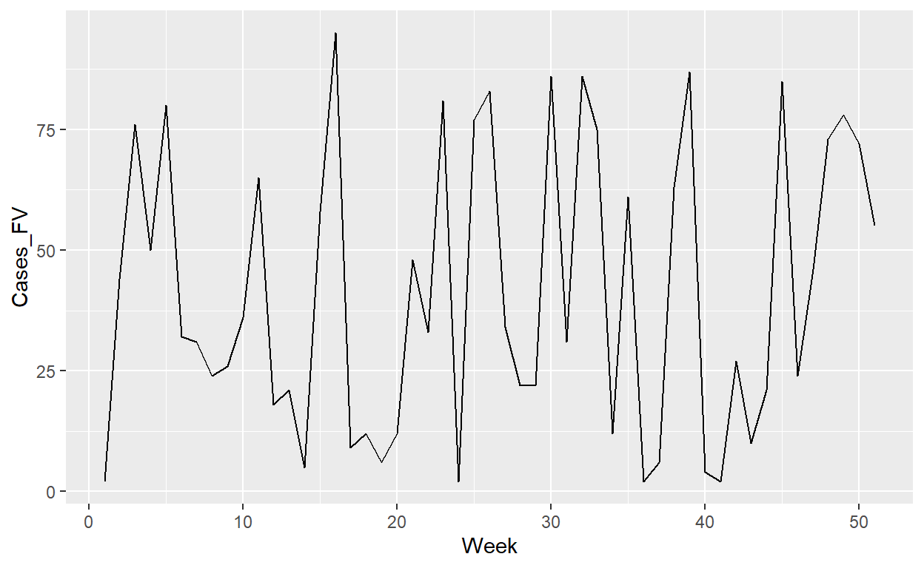
Solution to Exercise A.2

Slide 21
What if you want to add points?
Line Layer
Point Layer
Line-Point Layer
You can add layers upon layers

Slide 22
geom_point()

Slide 23
EXERCISE A.2 +

Slide 24
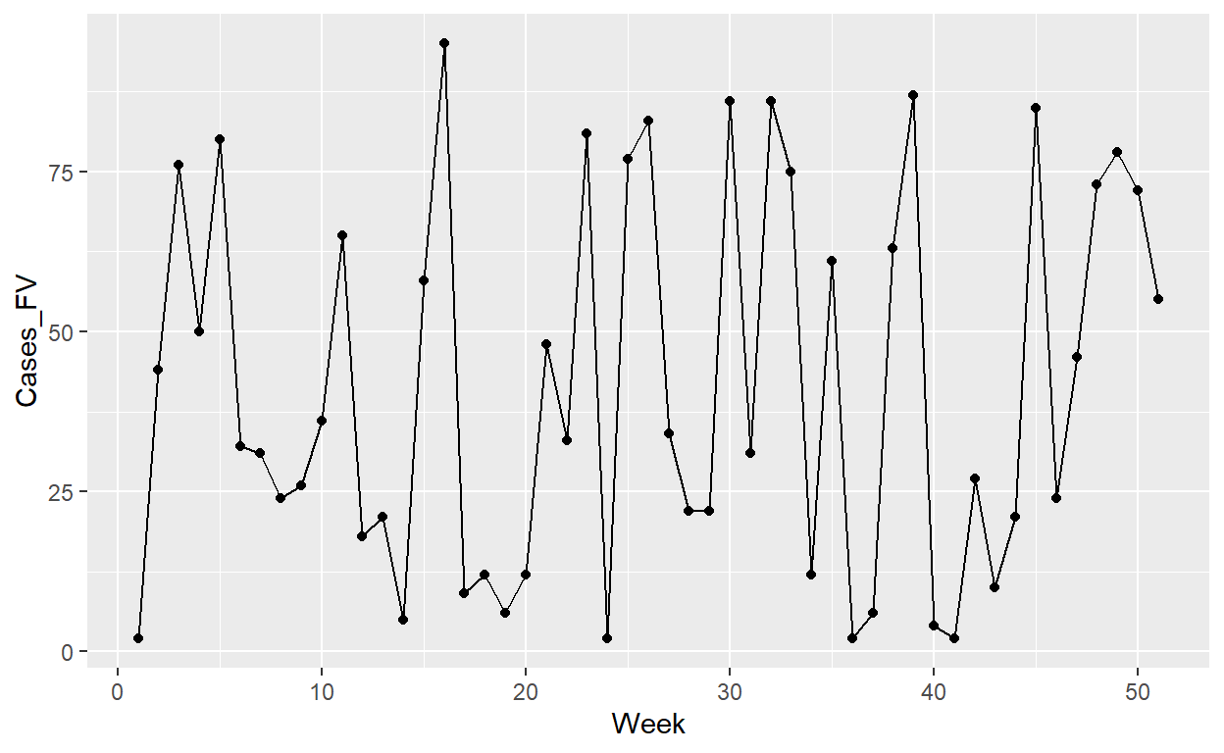
Solution to Exercise A.2 +!

Slide 25
Changing the Color/Size/Etc.
In each geometric layer, we can change the appearance:
Color
Size
Alpha (Transparency)
Linetype
Shape

Slide 26
Go to the specific layer to change
For example, let’s say I want to change color of the line- I’ll go to geom_line() and add in the color I want
Example:
geom_line(color = ‘colorchoice’)
geom_point(size = number)

Slide 27
EXERCISE A.3

Slide 28
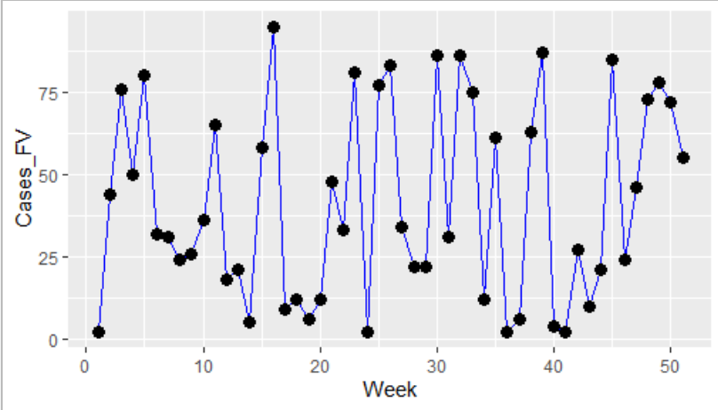
Solution to Exercise A.3!

Slide 29
The first layer has to do with the data + The second layer has to do with the representation

Slide 30
Honestly, don’t bother memorizing theme…yet
Only do theme when you’re finalizing graphs to present/publish
Personally, feel that going through theme in an intro workshop is a bit too much
But there’s very simple theme set that I use all the time (default gray is ugly)

Slide 31
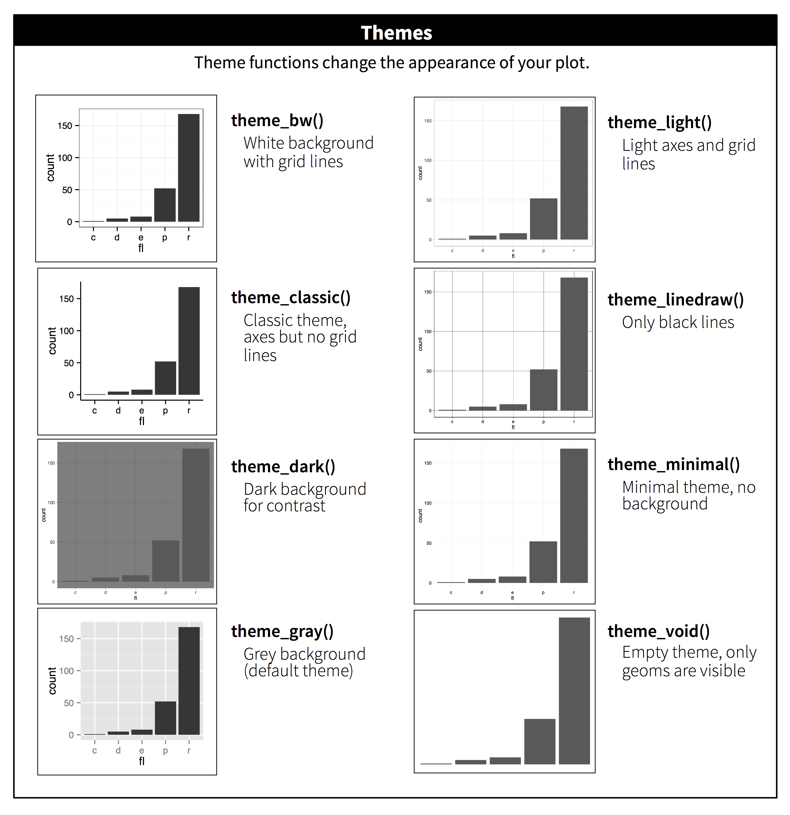

Slide 32
Again theme is another layer, it’s what you do at the end so it’s generally at the higher layers Think of like decorating a room, it’s the little touches at the end Let’s do theme_bw()

Slide 33
theme_bw()

Slide 34
EXERCISE A.4

Slide 35
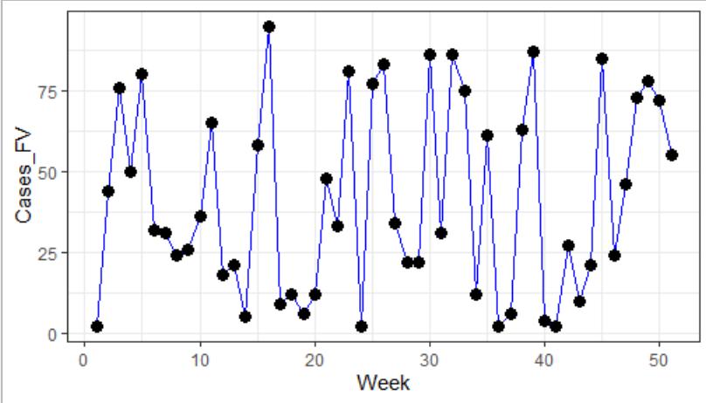
Solution to Exercise A.4!

Slide 36
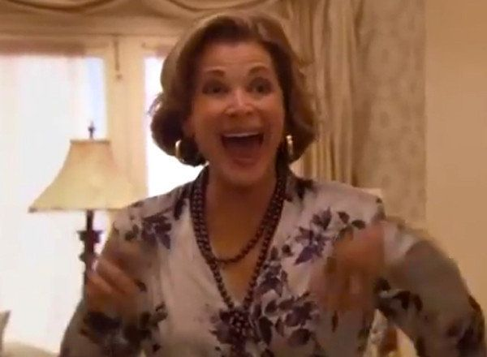
Your first ggplot2!

Slide 37
The sole intuition:
ggplot is about overlaying layers and figuring out what layers you need to work on!
As you start to make more complicated graphs, you just need to think layers.
Sketch everything by hand

Slide 38
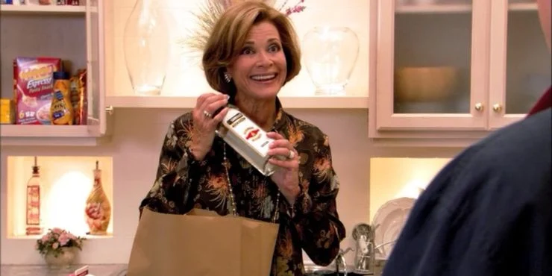
Melt
Part B: Line plots but with more lines

Slide 39
Lot of the times you will have to reformat your data before you can put it through ggplot2

Slide 40
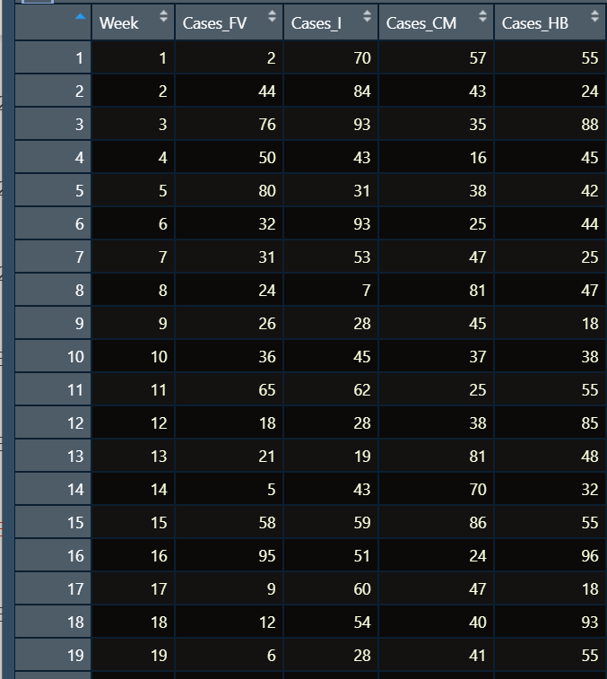
Let’s look at the data.frame
WIDE FORMAT- Each variable is its own column

Slide 41
ggplot(data, aes(x= week, y= county1))+geom_line()+
geom_line(data = data, aes(x = week, y = county2))+
geom_line(data=data, aes(x = week, y=county3))

Slide 42
What happens if you don’t reformat your data
Layer 1001 for Variable 1001
Layer 3 for Variable 3
Layer 2 for Variable 2
Layer 1 for Variable 1

Slide 43
Converting wide to long format is a crucial skill (not only for data.viz but a lot of analysis packages)

Slide 44
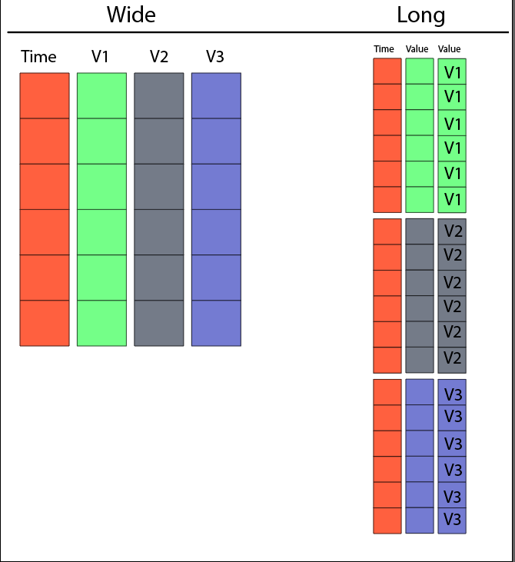

Slide 45
There’s so many functions/packages but I’m used to reshape2::melt function (OG package here) (have no idea what other packages are)

Slide 46
The reshape formula
melt(df, id.vars=c(“ “))
I still don’t really get it, I just know by instinct

Slide 47
Exercise B.1

Slide 48
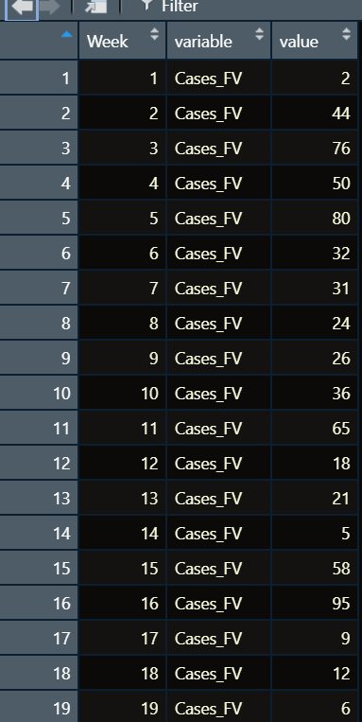
Solution to B.1

Slide 49
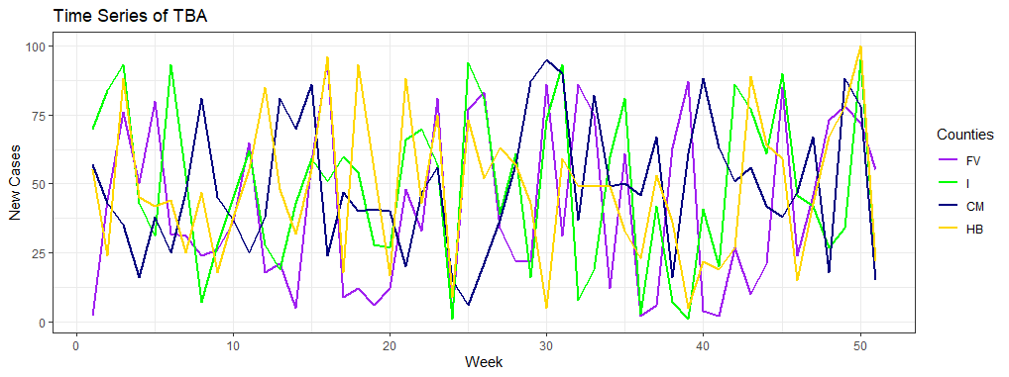
Let’s get plotting: Our end goal is this

Slide 50
What is the first layer everyone?

Slide 51
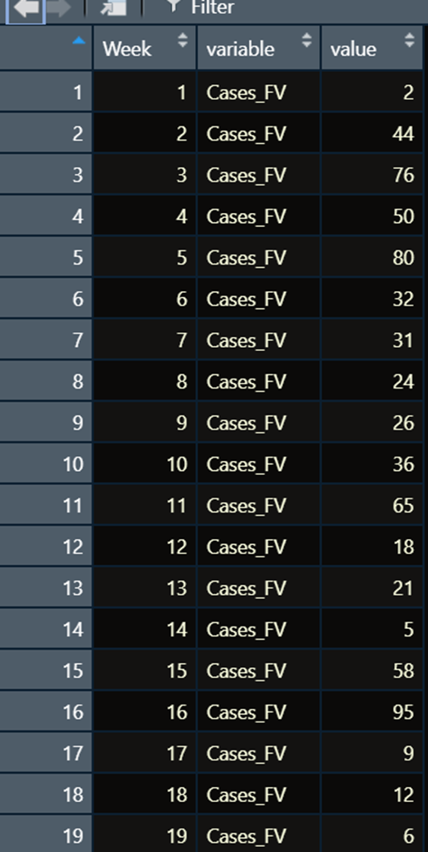
Value
Week

Slide 52
Exercise B.2

Slide 53
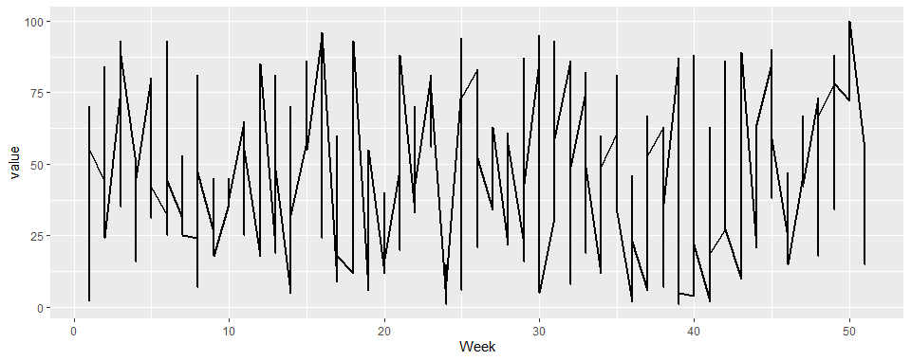
Solution to B2

Slide 54
What went wrong?
In ggplot2 mind, you gave it a column of just weeks and numbers.
They weren’t aware that there was grouping- so you must tell ggplot2 that.

Slide 55
When you have multiple groups
Remember we want each line to represent a county.
We must explicitly tell ggplot2 that color is associated with different variable

Slide 56
The formula
ggplot(data, aes(x = variable_x, y= variable_y, color = variable))
Putting it into aes is important

Slide 57
Exercise B.3

Slide 58
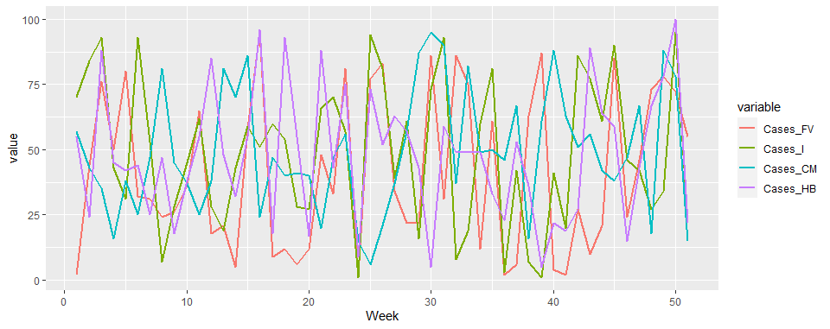
Solution to B.3!

Slide 59
Now R automatically gives us colors but let’s say we want to manually change it.

Slide 60
Introduction to the scale layer
Scale layer controls how the data value is scaled to the visual value (different colors, different sizes, so on)
For example, different counties being scaled to different colors

Slide 62
scale_color_manual()

Slide 63
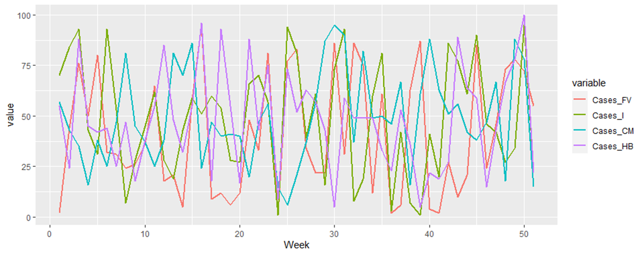

Slide 64
scale_color_manual(name="Counties“,
labels=c("FV","I","CM",'HB'),
values=c("purple","green","navy",'gold'))

Slide 65
Exercise B.4

Slide 66
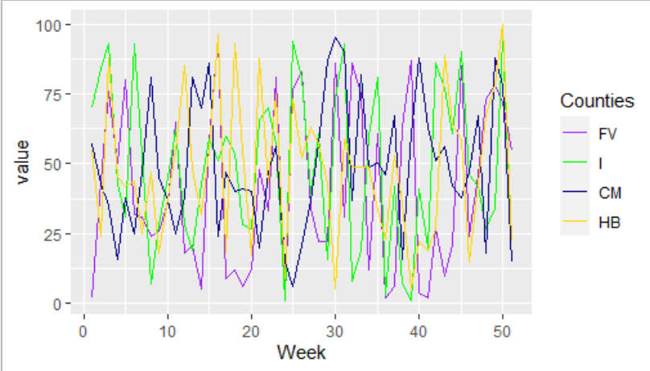
Answers to Exercise B.4

Slide 68
xlab()+ ylab()+ggtitle()

Slide 69
Exercise B.5

Slide 70
Exercise B.6

Slide 71
Congrats… but it’s really hard to read.

Slide 72
The evident Power of ggplot2 is facet
I use something called facet- it creates a separate graph each county
it’s just another layer!

Slide 73
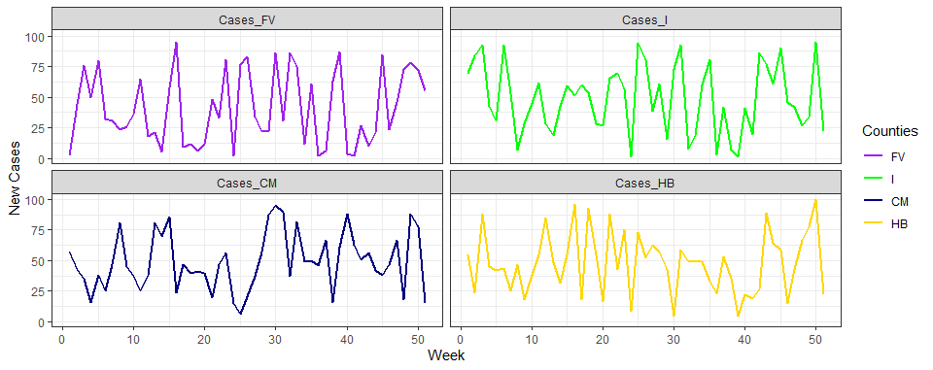
Let’s get plotting: Our end goal is this

Slide 74
The new layer is just facet_wrap
The formula:
facet_wrap(variable1 ~ variable2)
facet_wrap( ~variable1

Slide 75
Exercise B.7

Slide 76
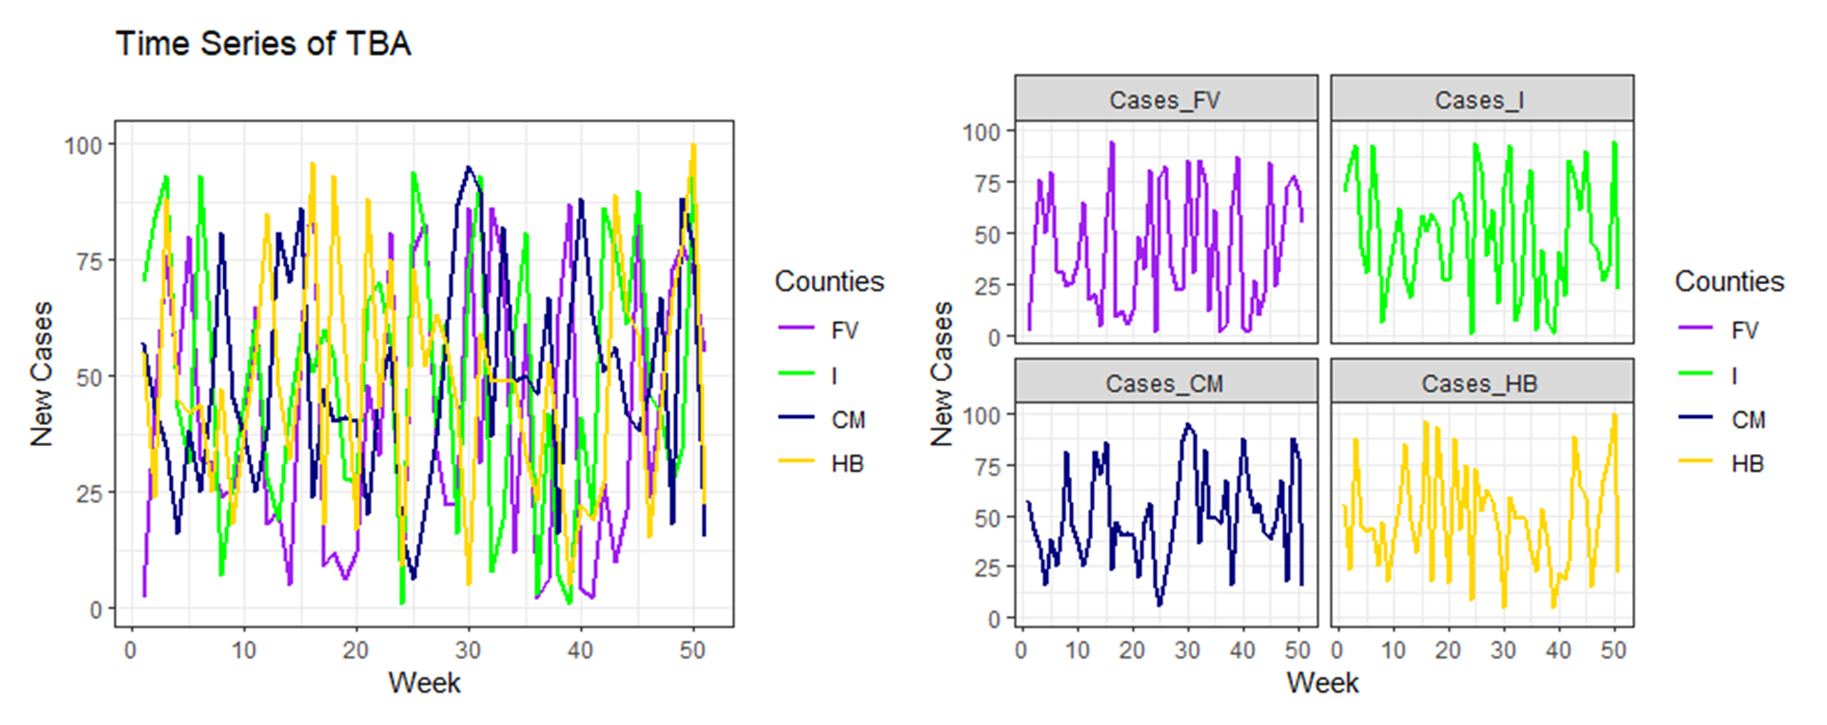
How to do multiplots
Many many packages (gridExtra was what I used before the birth of patchwork last year )

Slide 77
Patchwork
Again multiple ways to arrange plots together.
Patchwork is the easiest for me, remember it’s a package so you have to install it first

Slide 78
You can assign a ggplot2 as a variable
Example:
Plot1 <- ggplot(data, aes(x = xvariable, y = yvariable))+geom_line()
> Plot1
Bam a plot!

Slide 79
Patchwork FRAMEWORK
If you want to have two plots side to side use: plot1 + plot2
If you want to have two plots on top of each other use: plot1/plot2 With more plots, you can do more complicated graphs

Slide 80
Exercise B.8

Slide 81
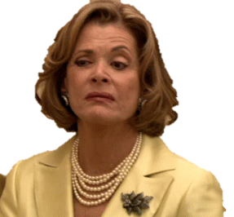
Part C: Barplots

Slide 82
Okay now you jumped into the pool of ggplot2, let’s keep doing a little bit more drills

Slide 83

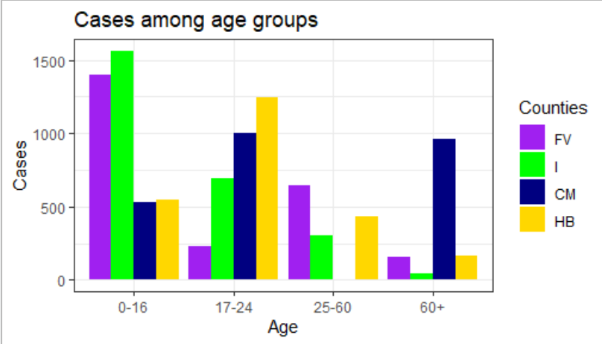

Slide 84
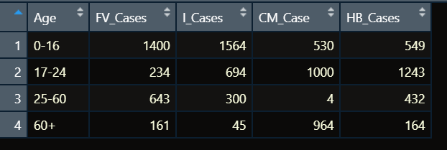
First we must melt!

Slide 85
Exercise C.1

Slide 86
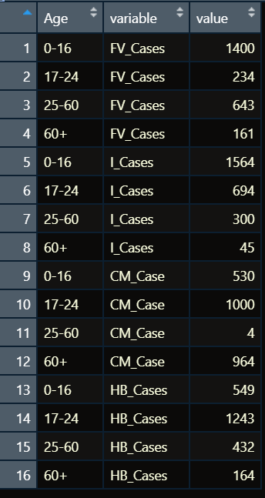
Solution to Exercise C.1

Slide 87
Data Layer!

Slide 88
Exercise C.2

Slide 89
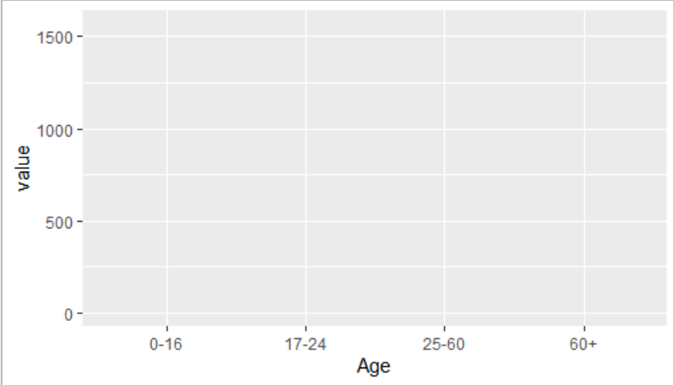
Answer to Exercise C.2

Slide 90
geom_bar()

Slide 91
A quirk of geom_bar
You must explicitly tell geom_bar(stat=‘identity’) or it won’t work

Slide 92
Exercise C.3

Slide 93
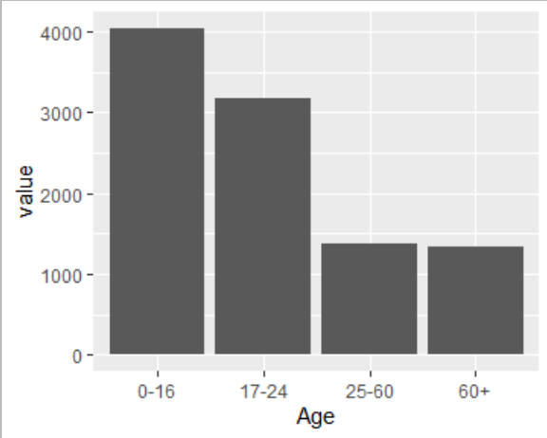
Exercise C.3 Solution

Slide 94

Again the same problem with the multiple line

Slide 95
Remember to say hey I want to incorporate the grouping
For anything that has an ‘area’ you use fill, color represents the border:
Geom_line() + geom_point()- Use color
Geom_bar = Use fill

Slide 96
Exercise C.4

Slide 97
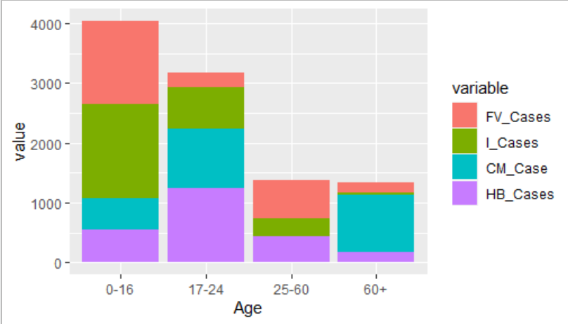
Solution C.4

Slide 98
I want to change the position of the bar

Slide 99
Exercise C.5

Slide 100
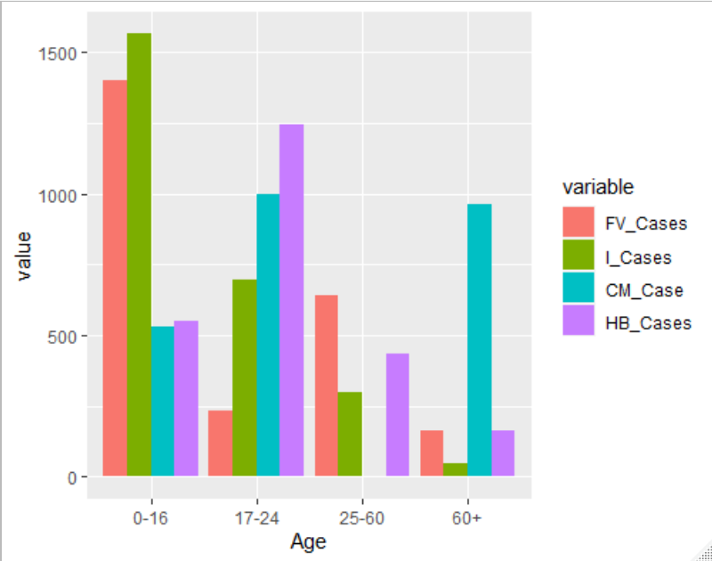
Answer to C.5

Slide 101
Now change the color
scale_fill_manual(name="Counties",
labels=c("FV","I","CM",'HB'),
values=c("purple","green","navy",'gold'))

Slide 102
Exercise C.6
Watch out for scale_butt_manual

Slide 103
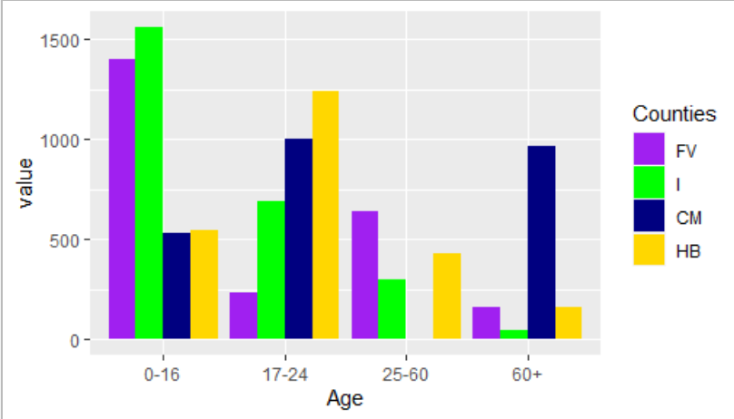
Answer to C.6

Slide 104
Change the title and the theme

Slide 105
Exercise C.7

Slide 106

plots
ggplot2
Part D (final): Tiled plots

Slide 107

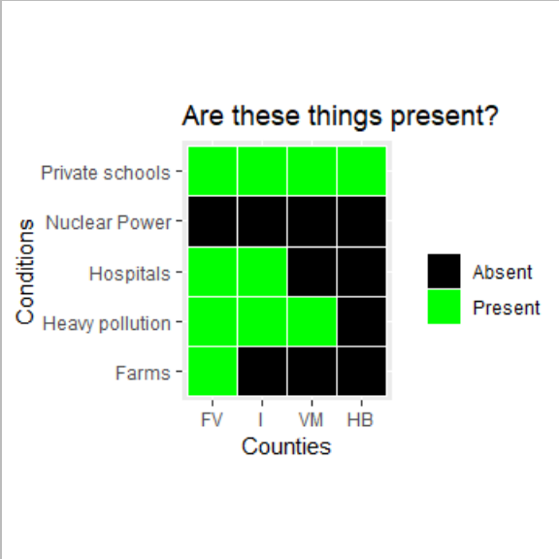

Slide 108
We really need to be adding geom_tile
They can be visually striking and informative
Somewhat underused

Slide 109
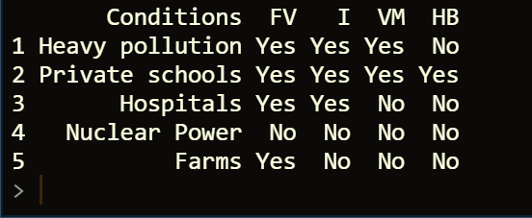
Again! Melt!

Slide 110
Exercise D.1

Slide 111
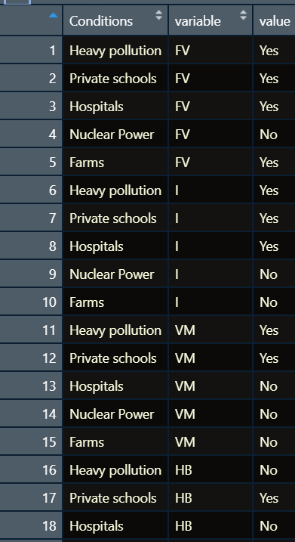
Answer to D.1

Slide 112
Exercise D.2

Slide 113
First Layer!

Slide 114
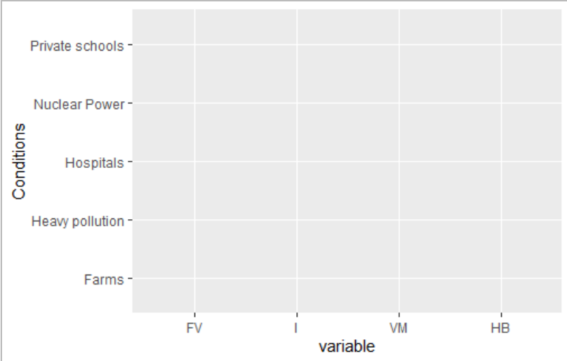
Answer to D.2

Slide 115
Geom_tiles()

Slide 116
Exercise D.3

Slide 117
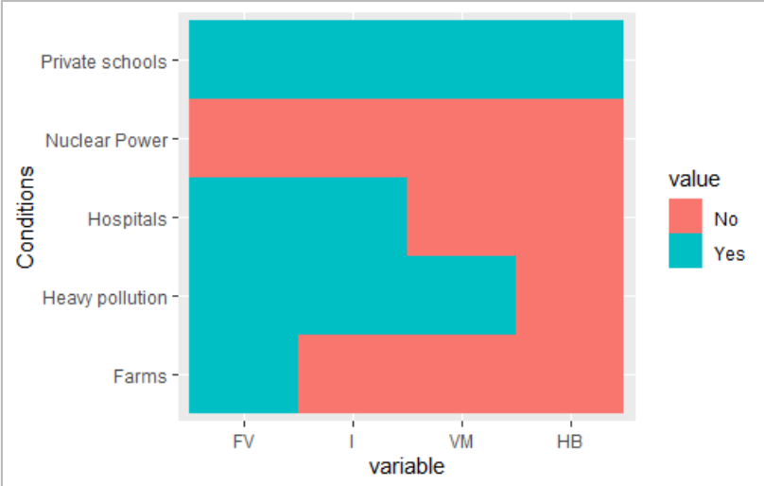
Answer to D.3

Slide 118
Okay need some border between the tiles

Slide 119
Exercise D.4

Slide 120

Answer to D.4

Slide 121
Change the scale layer

Slide 122
Exercise D.5

Slide 123
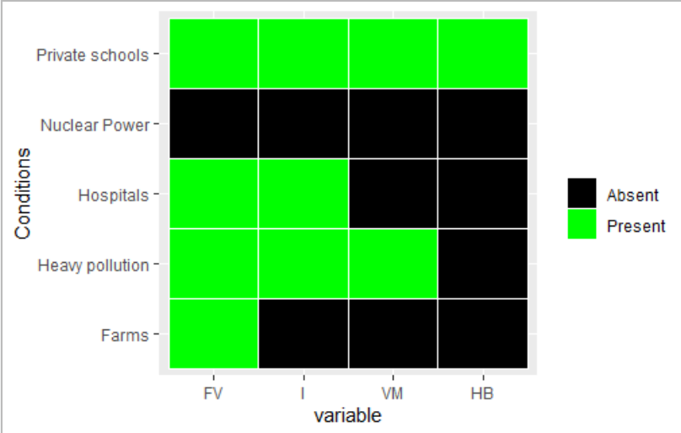
Answer to D.5

Slide 124

Change the label and theme

Slide 125
Exercise D.6

Slide 126
Fin

Slide 127
For future stuff
I want to do smaller workshops for spatial mapping (the worst thing ever) and interactive stuff.
Lol you can’t get on our list-serv unfortunately, but I tweet an insane amount (@pakdamie) so you can see what I’m up to

Slide 128
How to get better
Twitter and people specializing in data-viz
Find the most niche thing you love and data-viz it
Email me cause I love procrastinating from work
Google, google, google, google, google

Slide 129
Questions?

